Slide 1
Course Code:CSC402A Course Title: Web Architecture and Application Development
Course Leader:
Kishore S.M.
kishore.cs.et@msruas.ac.in

Slide 2
Objectives
After completing this lecture, the student will be able to
Describe distributed architecture
Analyze client server architecture
Analyze 1-tier, 2-tier, 3-tier and N-tier architecture

Slide 3
Contents
Client Server architecture
1-tier, 2-tier, 3-tier and N-tier architecture

Slide 4
Distributed Architectures
A distributed system is a collection of computational and storage devices connected through a communications network
In this type of system, data, software, and users are distributed
The subsystems or components within a distributed system communicate with each other using a number of methods including message passing, remote procedure calls, and remote method invocation
A distributed system can be modeled by the client-server architecture, and this forms the basis for multi-tier architectures

Slide 5
Distributed Architectures
Alternatives are the broker architecture such as CORBA, and the service-oriented architecture (SOA) such as web services and grid services
Key features of a distributed architecture are its service location transparency and its services reliability and availability

Slide 6
Distributed Architectures
Client-Server
The client-server model is the most commonly distributed system architecture
It is based on two communicating processes, usually running on different processors, and thus decomposes a system into two major subsystems: client and server
The first process, the client, issues a request to the second process, the server
The server process receives the request (serving data from a database, printing a document), carries it out, and sends a reply to the client

Slide 7
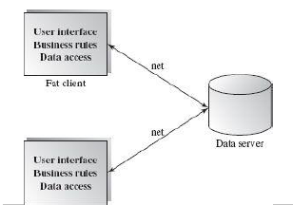
Distributed Architectures
Client-Server

Slide 8
Distributed Architectures
Client-Server
Advantages:
•Separation of responsibilities such as user interface presentation and business logic processing
•Reusability of server components
Disadvantages:
•Lack of heterogeneous infrastructure to deal with the requirement changes
• Security complications
• Server availability and reliability
• Testability and scalability
• Fat clients with presentation and business logic together

Slide 9
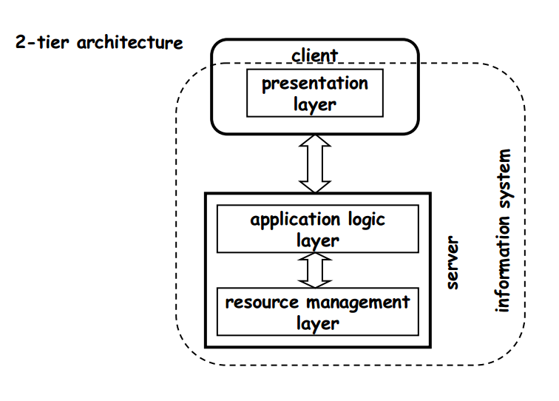
Two Tier

Slide 10
2 Tier Architecture - Advantages
Technical advantages when going from one tier to two tier architectures:
Take advantage of client capacity to off-load work to the clients
Work within the server takes place within one scope (almost as in 1 tier)
The server design is still tightly coupled and can be optimized by ignoring presentation issues
Still relatively easy to manage and control from a software engineering point of view

Slide 11
2 Tier Architecture - Disadvanatages
The server has to deal with all possible client connections
The maximum number of clients is given by the number of connections supported by the server
Clients are “tied” to the system since there is no standard presentation layer
If one wants to connect to two systems, then the client needs two presentation layers
There is no failure or load encapsulation
If the server fails, nobody can work. Similarly, the load created by a client will directly affect the work of others since they are all competing for the same resources

Slide 12
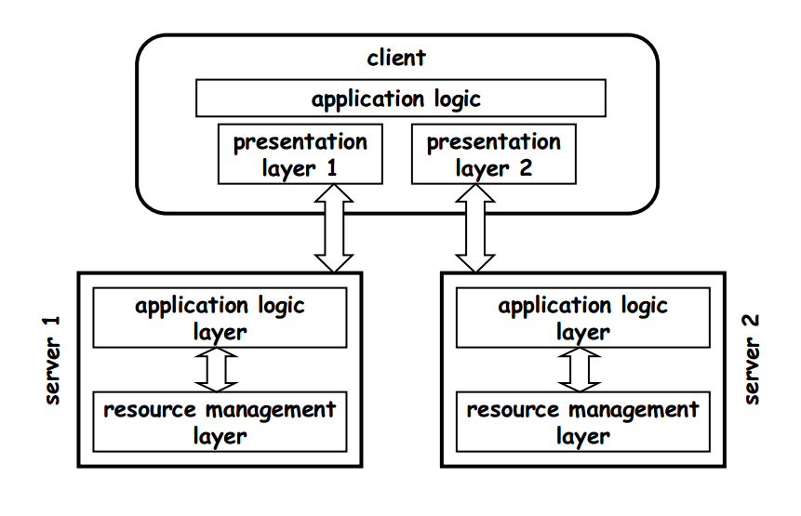
Main Limitation of Client/server

Slide 13
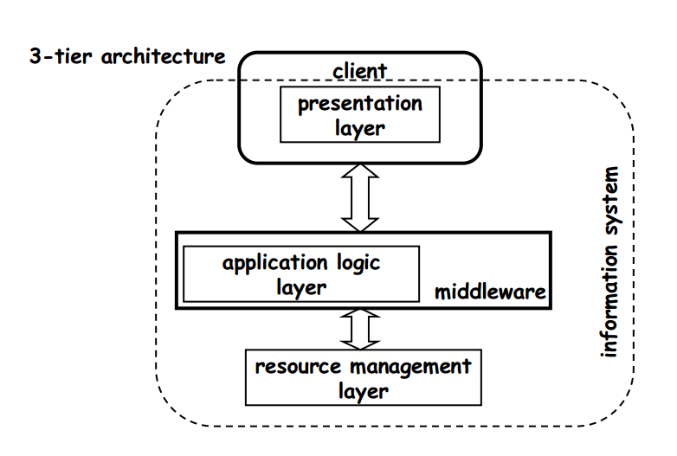
Three Tier

Slide 14
Three Layered Architecture
The presentation layer
Managing the user interfaces of applications, including desktop applications, Web browsers, and pervasive devices
Provides a Web Server
Servlet and JSP results caching and JSP tags caching
Provides high-reliability, scalability, monitoring, and other features required by enterprise applications

Slide 15
Three Layered Architecture
The business layer
Contains the application’s business logic independent of the user interface, including distributed components, running in the application server environment
Enterprise Java Beans
The back-end layer
Provides connectivity with enterprise systems and databases
Databases, ERP, CRM, mainframe or other existing applications

Slide 16
Application Servers & 3-Tiered Systems
3-tiered systems are common in e-commerce and B2B applications
Application servers provide a framework for middle-tier applications
Presentation
Business Rules
Services include
Database connectivity
Client connectivity
Resource management
Users/Customers (e-commerce)
Tier 1
Application Server
Tier 2
Presentation Logic
Other Businesses (B2B)
Business Rules
Tier 3
Database
16
Notes:
16
16
16

Slide 17
Web Development Usage
In the web development field, three-tier is often used to refer to websites, commonly electronic commerce websites, which are built using three tiers:
A front-end web server serving static content, and potentially some cached dynamic content
In web based application, Front End is the content rendered by the browser
A middle dynamic content processing and generation level application server
Examples - Java EE, ASP.NET, PHP, Python platform
A back-end database or data store
Comprising both data sets and the database management system software

Slide 18
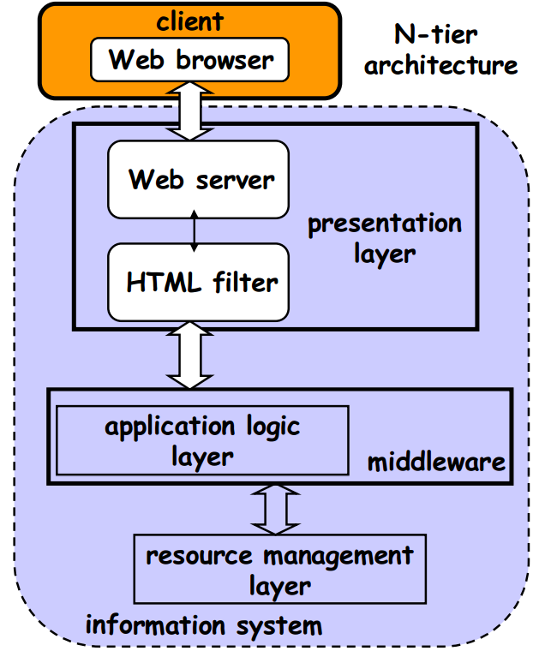
N-tier: Connecting to the Web

Slide 19
Advantages of Layered Architecture
Each layer is selected to be a set of related services
The architecture provides high degree of cohesion within the layer
Each layer may hide private information from other layers
Layers may use only lower layers, constraining the amount of coupling
Each layer, being cohesive and is coupled only to lower layers, makes it easier for reuse by others and easier to be replaced or interchanged
Change of DB touches only the data store/access layer, change of browser only changes the presentation layer of the previous slide
Good for component design

Slide 20
Summary
A distributed system is a collection of computational and storage devices connected through a communications network
The client-server model is the most commonly distributed system architecture

